Slide 1
Pořádek dělá přátele
PŘESNÉ PARKOVÁNÍ
SDÍLENÝCH KOL A KOLOBĚŽEK

Slide 2
NAŠE MISE
Poskytnout inovativní řešení, které umožňuje na centimetr přesné parkování sdílených kol, elektrokol a elektrokoloběžek v určených městských oblastech.
Nabídnout kvalitní službu městským úřadům, obyvatelům měst a uživatelům mikromobility.
Abychom ověřili efektivitu našich řešení, provedeme jeho důkladné testování v Madridu a Praze.

Slide 3
JAKÝ PROBLÉM ŘEŠÍME
Trend ukazuje rostoucí využití mikromobility pro každodenní dojíždění jak v ochotě občanů (70 %)*, tak v nárůstu investic** – zvyšuje tlak na městskou infrastrukturu.
Chybí systematický přístup k používání jízdních kol, elektrokol a elektrokoloběžek.
Vznikají přeplněné parkovací plochy nebo jsou prostředky parkovány špatně, mimo vyhrazené zóny.
*McKinsey & Company. (2021). Why Micromobility Is Here to Stay. Retrieved from: https://www.mckinsey.com/industries/automotive-and-assembly/our-insights/why-micromobility-is-here-to-stay#/
**McKinsey & Company. (2020). How the pandemic has reshaped micromobility investments. Retrieved from: https://www.mckinsey.com/features/mckinsey-center-for-future-mobility/mckinsey-on-urban-mobility/how-the-pandemic-has-reshaped-micromobility-investments
Notes:
Challenge:
Cities encounter challenges of emission reduction, enhancing safety and mobility for cyclists and pedestrians, and citizens' quality of life. Multimodal transportation is crucial for achieving sustainable mobility. The post covid transport patterns demonstrate an uptake in usage of micro mobility for daily commuting both in the willingness of citizens (70% of respondents across regions) (McKinsey, 2021) and in the investment soar (McKinsey, 2022).
The growth in the usage of micro mobility solutions puts pressure on urban infrastructure. The current reality reveals a lack of systematic approach to the use of bicycles, e-bikes, and e-scooters, leading to issues such as overcrowded parking areas or improper parking outside designated zones. Our data analysis highlights a significant portion of these vehicles remaining unused for extended periods, causing inefficiencies within the overall multimodal system.

Slide 4
NAVRHOVANÉ ŘEŠENÍ
vymezení parkovacího místa širokého až 12m pro prostředky mikromobility s přesností parkování na 1 cm (několikanásobně vyšší než u GPS parkování)
integrace s aplikacemi operátorů
PARK
Notes:
Proposed Innovation:
“Parked by me” aims to further advance the technology of state-of-the-art Bluetooth sensors (patents approved in Norway ) and smart application to enable precise parking of shared bicycles, e-bikes, and e-scooters within designated areas. The goal is to increase the accuracy of parking to centimetre level by developing algorithms for positioning and detecting the direction of the BLE-Tag, which allows for expanded parking spaces up to 12 metres wide.
According to the Vienna case (2020), geofences play a crucial role in the success of micro mobility solutions. In addition, the city of Munich, where micromobility is expected to reach 30% share by 2030 (McKinsey, 2019), approached the solution provider Sparparkto test thehigh-precision parking solution, confirmed by the Munich LOI (in Annex). Our solution empowers cities to analyze the utilization and parking patterns of shared micro mobility vehicles, enabling them to make informed adjustments and deploy smarter parking zones (geofences) for enhanced efficiency.
Within the project scope, we target cities where there is an already established network of bicycles, e-bikes and e-scooters and citizens use them on a regular basis. The vehicles are shared micromobility vehicles, owned by rental organizations. In the long run, we envisage the benefit also for the municipalities which focus on regulating the usage of vehicles individually owned.
Benefits:
Municipalities can benefit from improved and safer parking and increased and more efficient usage of shared bicycles, e-bikes, e-mopeds and e-scooters. For vehicle users, a smooth user experience will be ensured by connecting thesolution to already existing applications for renting bicycles, e-bikes and e-scooters.
The project aims at improving the multi-modal set-ups and traffic flow in cities. It provides a data-driven alternative to regulating micro mobility transport by policies. Citizens will benefit from increased reliability, accessibility and availability of the vehicles thanks to the optimised usage.

Slide 5
DVĚ PILOTNÍ MĚSTA
Ve spolupráci s pražskými a madridskými municipalitami a místními poskytovateli služeb mikromobility spustíme 1-měsíční pilotní provoz v každém městě.
Plánujeme rozmístit 25 senzorů v každém městě a budeme testovat rozdíl mezi přístupem se senzory SparkPark nebo bez senzorů pomocí GPS.
Notes:
Proposed Innovation:
“Parked by me” aims to further advance the technology of state-of-the-art Bluetooth sensors (patents approved in Norway ) and smart application to enable precise parking of shared bicycles, e-bikes, and e-scooters within designated areas. The goal is to increase the accuracy of parking to centimetre level by developing algorithms for positioning and detecting the direction of the BLE-Tag, which allows for expanded parking spaces up to 12 metres wide.
According to the Vienna case (2020), geofences play a crucial role in the success of micro mobility solutions. In addition, the city of Munich, where micromobility is expected to reach 30% share by 2030 (McKinsey, 2019), approached the solution provider Sparparkto test thehigh-precision parking solution, confirmed by the Munich LOI (in Annex). Our solution empowers cities to analyze the utilization and parking patterns of shared micro mobility vehicles, enabling them to make informed adjustments and deploy smarter parking zones (geofences) for enhanced efficiency.
Within the project scope, we target cities where there is an already established network of bicycles, e-bikes and e-scooters and citizens use them on a regular basis. The vehicles are shared micromobility vehicles, owned by rental organizations. In the long run, we envisage the benefit also for the municipalities which focus on regulating the usage of vehicles individually owned.
Benefits:
Municipalities can benefit from improved and safer parking and increased and more efficient usage of shared bicycles, e-bikes, e-mopeds and e-scooters. For vehicle users, a smooth user experience will be ensured by connecting thesolution to already existing applications for renting bicycles, e-bikes and e-scooters.
The project aims at improving the multi-modal set-ups and traffic flow in cities. It provides a data-driven alternative to regulating micro mobility transport by policies. Citizens will benefit from increased reliability, accessibility and availability of the vehicles thanks to the optimised usage.

Slide 6
PARTNEŘI PROJEKTU
SPARKPARK (NO) - Norští experti na patentované digitální parkovací systémy pro vozidla mikromobility.
FACTUAL (ES) – Foresightová inovační a strategická firma, která se zaměřuje na transformaci mobility.
PowerHUB (CZ) - organizace pro transfer technologií specializující se na mobilitu
MČ Praha 7
Město Madrid

Slide 7
VÝHODY
možnost analyzovat způsoby využití a parkování vozidel sdílené mikromobility
provádět informovaná rozhodnutí a zavádět chytřejší parkovací zóny (tzv. geofencing)
zvýšení efektivity mikromobilního parkování
žádné e-koloběžky válející se po ulici či špatně zaparkovaná kola
Notes:
Proposed Innovation:
“Parked by me” aims to further advance the technology of state-of-the-art Bluetooth sensors (patents approved in Norway ) and smart application to enable precise parking of shared bicycles, e-bikes, and e-scooters within designated areas. The goal is to increase the accuracy of parking to centimetre level by developing algorithms for positioning and detecting the direction of the BLE-Tag, which allows for expanded parking spaces up to 12 metres wide.
According to the Vienna case (2020), geofences play a crucial role in the success of micro mobility solutions. In addition, the city of Munich, where micromobility is expected to reach 30% share by 2030 (McKinsey, 2019), approached the solution provider Sparparkto test thehigh-precision parking solution, confirmed by the Munich LOI (in Annex). Our solution empowers cities to analyze the utilization and parking patterns of shared micro mobility vehicles, enabling them to make informed adjustments and deploy smarter parking zones (geofences) for enhanced efficiency.
Within the project scope, we target cities where there is an already established network of bicycles, e-bikes and e-scooters and citizens use them on a regular basis. The vehicles are shared micromobility vehicles, owned by rental organizations. In the long run, we envisage the benefit also for the municipalities which focus on regulating the usage of vehicles individually owned.
Benefits:
Municipalities can benefit from improved and safer parking and increased and more efficient usage of shared bicycles, e-bikes, e-mopeds and e-scooters. For vehicle users, a smooth user experience will be ensured by connecting thesolution to already existing applications for renting bicycles, e-bikes and e-scooters.
The project aims at improving the multi-modal set-ups and traffic flow in cities. It provides a data-driven alternative to regulating micro mobility transport by policies. Citizens will benefit from increased reliability, accessibility and availability of the vehicles thanks to the optimised usage.

Slide 8
PILOT V PRAZE
Notes:
Proposed Innovation:
“Parked by me” aims to further advance the technology of state-of-the-art Bluetooth sensors (patents approved in Norway ) and smart application to enable precise parking of shared bicycles, e-bikes, and e-scooters within designated areas. The goal is to increase the accuracy of parking to centimetre level by developing algorithms for positioning and detecting the direction of the BLE-Tag, which allows for expanded parking spaces up to 12 metres wide.
According to the Vienna case (2020), geofences play a crucial role in the success of micro mobility solutions. In addition, the city of Munich, where micromobility is expected to reach 30% share by 2030 (McKinsey, 2019), approached the solution provider Sparparkto test thehigh-precision parking solution, confirmed by the Munich LOI (in Annex). Our solution empowers cities to analyze the utilization and parking patterns of shared micro mobility vehicles, enabling them to make informed adjustments and deploy smarter parking zones (geofences) for enhanced efficiency.
Within the project scope, we target cities where there is an already established network of bicycles, e-bikes and e-scooters and citizens use them on a regular basis. The vehicles are shared micromobility vehicles, owned by rental organizations. In the long run, we envisage the benefit also for the municipalities which focus on regulating the usage of vehicles individually owned.
Benefits:
Municipalities can benefit from improved and safer parking and increased and more efficient usage of shared bicycles, e-bikes, e-mopeds and e-scooters. For vehicle users, a smooth user experience will be ensured by connecting thesolution to already existing applications for renting bicycles, e-bikes and e-scooters.
The project aims at improving the multi-modal set-ups and traffic flow in cities. It provides a data-driven alternative to regulating micro mobility transport by policies. Citizens will benefit from increased reliability, accessibility and availability of the vehicles thanks to the optimised usage.

Slide 9
PILOT V PRAZE
Notes:
Proposed Innovation:
“Parked by me” aims to further advance the technology of state-of-the-art Bluetooth sensors (patents approved in Norway ) and smart application to enable precise parking of shared bicycles, e-bikes, and e-scooters within designated areas. The goal is to increase the accuracy of parking to centimetre level by developing algorithms for positioning and detecting the direction of the BLE-Tag, which allows for expanded parking spaces up to 12 metres wide.
According to the Vienna case (2020), geofences play a crucial role in the success of micro mobility solutions. In addition, the city of Munich, where micromobility is expected to reach 30% share by 2030 (McKinsey, 2019), approached the solution provider Sparparkto test thehigh-precision parking solution, confirmed by the Munich LOI (in Annex). Our solution empowers cities to analyze the utilization and parking patterns of shared micro mobility vehicles, enabling them to make informed adjustments and deploy smarter parking zones (geofences) for enhanced efficiency.
Within the project scope, we target cities where there is an already established network of bicycles, e-bikes and e-scooters and citizens use them on a regular basis. The vehicles are shared micromobility vehicles, owned by rental organizations. In the long run, we envisage the benefit also for the municipalities which focus on regulating the usage of vehicles individually owned.
Benefits:
Municipalities can benefit from improved and safer parking and increased and more efficient usage of shared bicycles, e-bikes, e-mopeds and e-scooters. For vehicle users, a smooth user experience will be ensured by connecting thesolution to already existing applications for renting bicycles, e-bikes and e-scooters.
The project aims at improving the multi-modal set-ups and traffic flow in cities. It provides a data-driven alternative to regulating micro mobility transport by policies. Citizens will benefit from increased reliability, accessibility and availability of the vehicles thanks to the optimised usage.

Slide 10
POHÁNÍME VAŠE INOVACE

Slide 11
Úvodní analýza
Hodnocení ESG7
Výpočet uhlíkové stopy
Report ESG
Strategie udržitelnosti a nastavení PR
NÁSTROJ +
STRATEGIE
Komplexní nástroj ESG / CSRD + strategie udržitelnosti
SOULAD S GRI a ESRS
Používáme indikátory od Global Reporting Initiative, taxonomii EU, máme certifikaci ISO 14001:2015 pro ESG

Slide 12
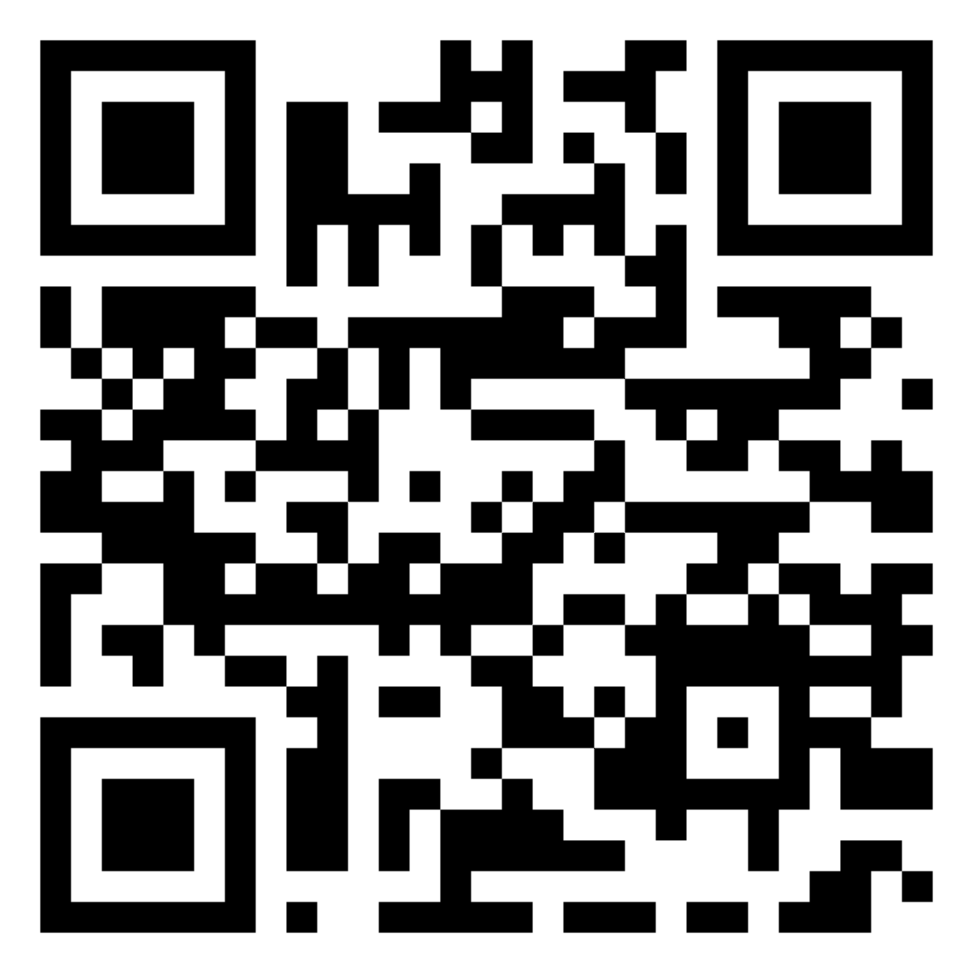
RISpire Trainings
Unikátní vzdělávací kurz, který je zdarma a bude se zaměřovat i na téma ESG
Pro vysokoškolské pracovníky, PhD. studenty, pracovníky městských úřadů nebo experty v oblasti dopravy
Klikni na QR kód a přihlas se, Train-the-trainers školící program je 25.-27.6.2024, dílčí vzdělávací kurzy budou k dispozici od září 2024

Slide 13
CHCETE OTESTOVAT PŘESNÉ PARKOVÁNÍ VE VAŠÍ OBCI NEBO SE NĚCO VÍC DOZVĚDĚT O ESG? SPOJTE SE S NÁMI!
E-mail
pavel@powerhub.cz
Telefon
+420 605 559 221
Web
SOCIÁLNÍ MÉDIA
www.powerhub.cz
@PowerHUB

