Slide 1
Říčany 2024

Slide 2
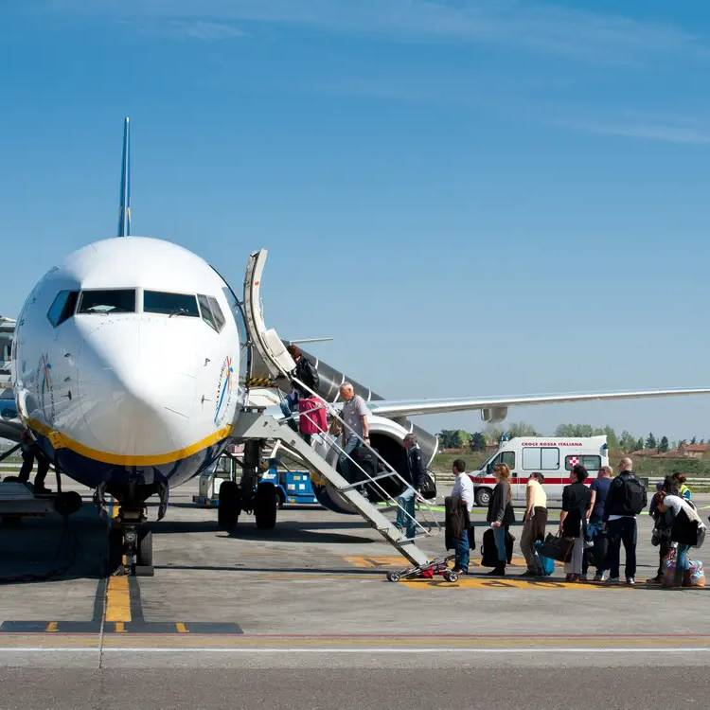
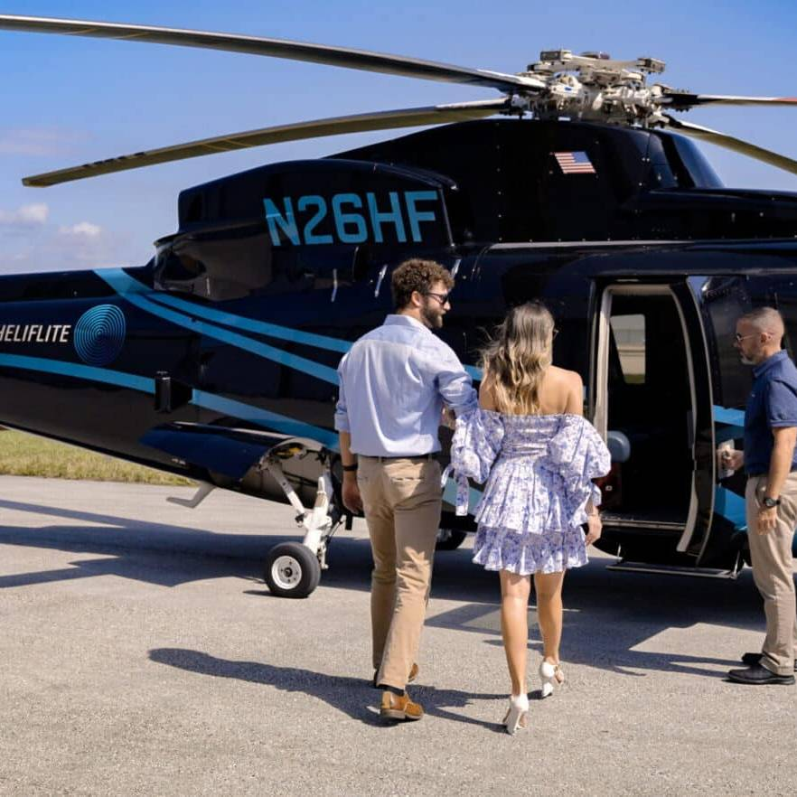
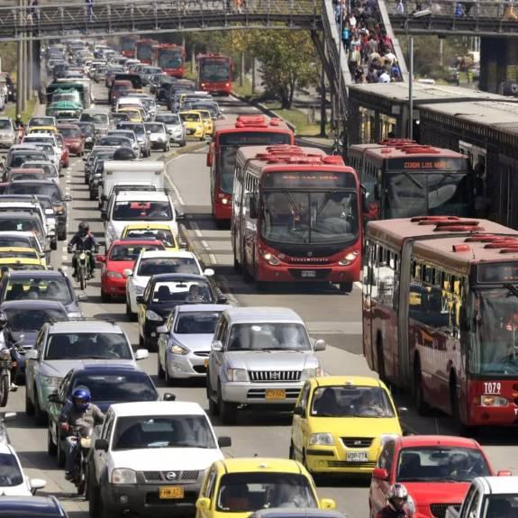
Problems in Mid-range Travel
Requires airport
Slow to takeoff (2h spent on getting to airport, going through checks, onboarding, waiting on runway) Emissions
Not on-demand.
Expensive Noisy Emissions.
Traffic jams Slow
Can’t cross water

Slide 3
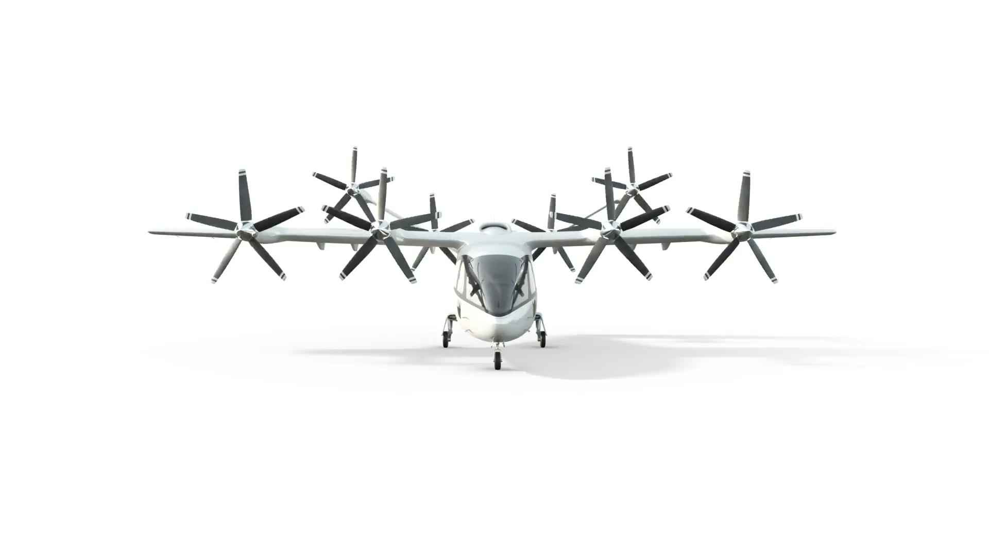
Solution: Zuri
700 km range with 30 min reserve
7x more than eVTOLs
300-350 km/h
cruise speed
Faster than helicopters or eVTOLs

Slide 4
Largescale Zuri: Flight tested
11-meter wingspan
Thoroughly flight tested in VTOL mode since summer 2021

Slide 5
Scaled model: Transition
Scaled model with tiltrotors
Tested in vertical, transition and horizontal mode. Throughout Zuri history, we tested 10+ scaled models.

Slide 6
Main business case Passengers
1 pilot, 4 passengers (or 5 in family interior)
Passenger Air Transport is $900 billion market today. Zuri targets its regional, premium part.

Slide 7
Second business case Cargo
Fits 2 standardized euro-pallets
Large doors 330 kg payload
Cargo Air Transport is $200 billion market today. Again, Zuri targets its regional, on-demand part.

Slide 8
Third business case Medivac / Search&Rescue
Faster and much quieter than helicopters
Note: These are not different aircraft. They are interior variants.
Customer can switch between them.

Slide 9
Competition
eVTOLs Joby, Lilium, Archer,... | Zuri a hybrid VTOL | Helicopter Airbus H135 as example
100-250 km | 900 km | 620 km
30-100 km | 700 km | 500 km
240-300 km/h | 350 km/h | 250 km/h
Range, absolute
Range, 30 min reserve
Top speed

Slide 10
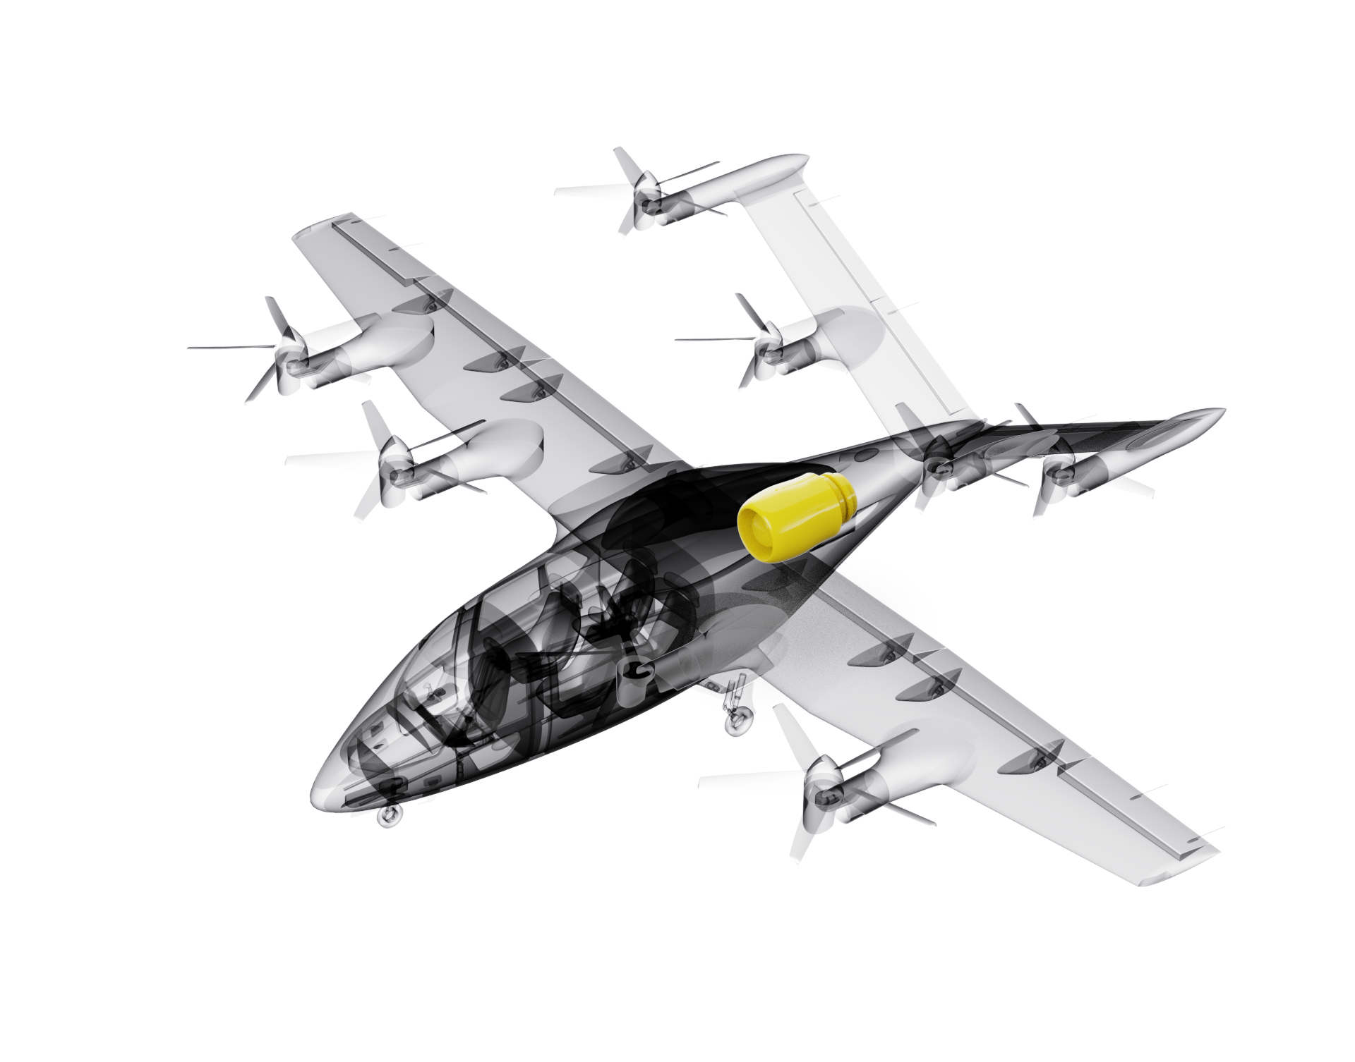
Hybrid Advantage
5x more energy
Best batteries:
230-280 Wh/kg¹
Hybrid powertrain
1360 Wh/kg²
1. Wh/kg means specific energy - energy stored per mass. 2. Weights are an example of 225 kg turbogenerator producing 600 kWh in 2 hours from 216 kg of fuel
And for comparison: Hydrogen is around 900 Wh/kg (total system weight, optimized for 2 hours)

Slide 11
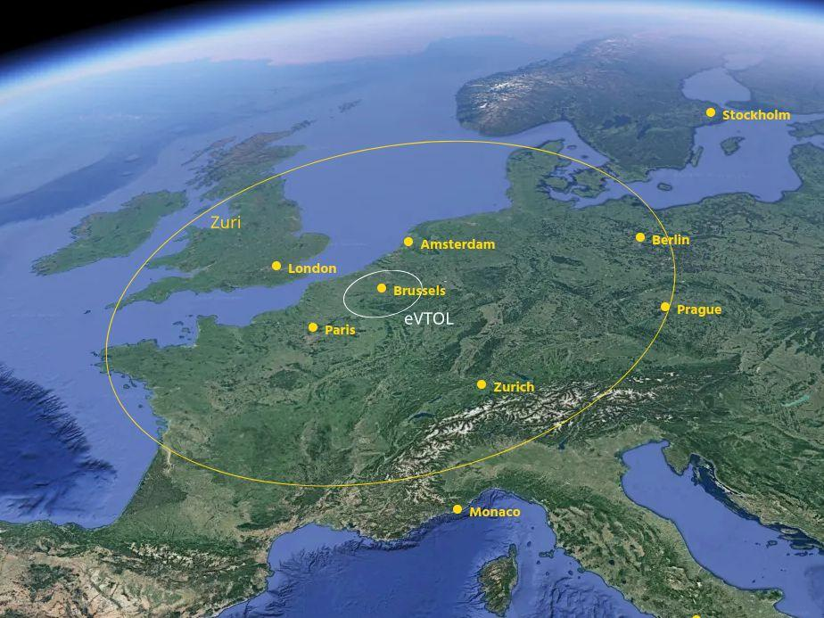
Competitive Advantage: Range
Comparison of usable range (with 30 min reserve)

Slide 12
VIP interior
Interior made mainly from sustainable materials.

Slide 13
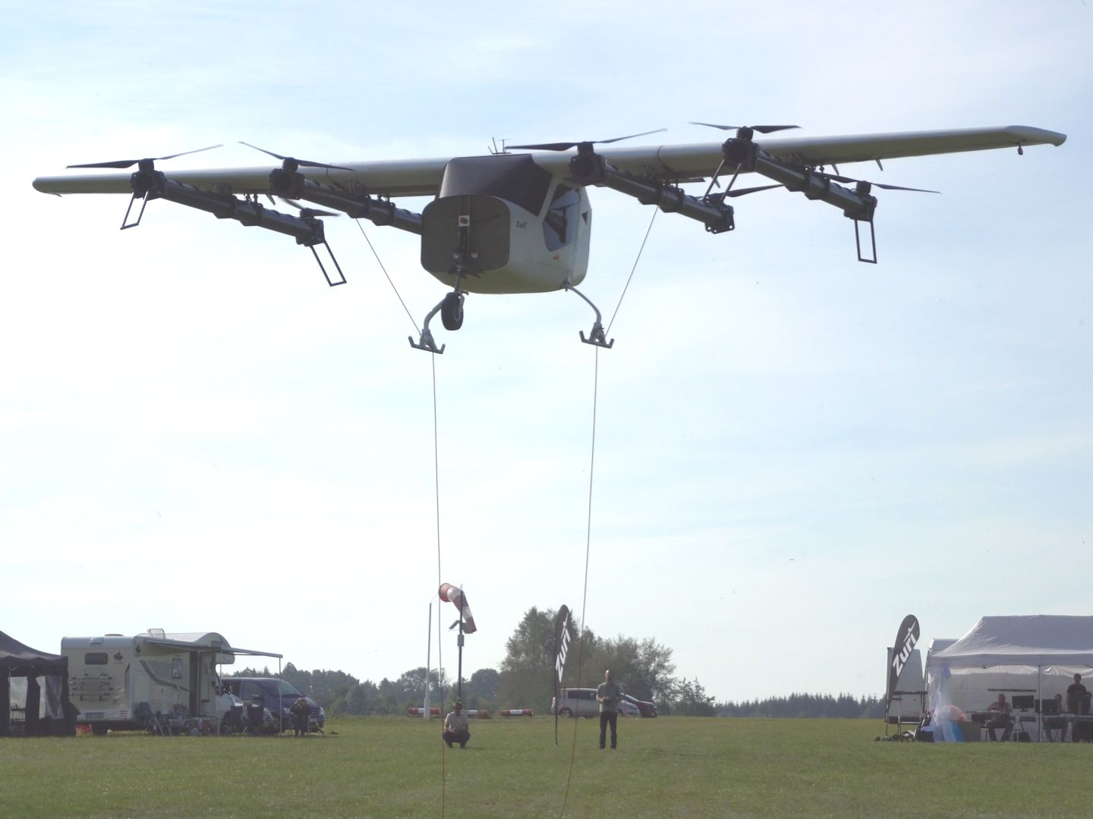
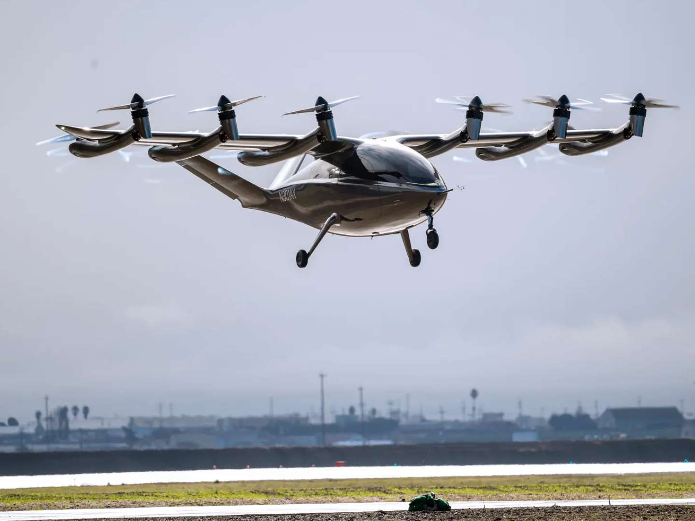
Zuri R&D is very money-efficient
Zuri 2-seater demonstrator
$1.5M spent until first VTOL flight
Czech Republic:
Low costs, high talent
Archer 2-seater demonstrator
$265M spent until first VTOL flight
Based in US

Slide 14
Sustainability
Zuri has lower CO₂ emissions than top eVTOLs

Slide 15
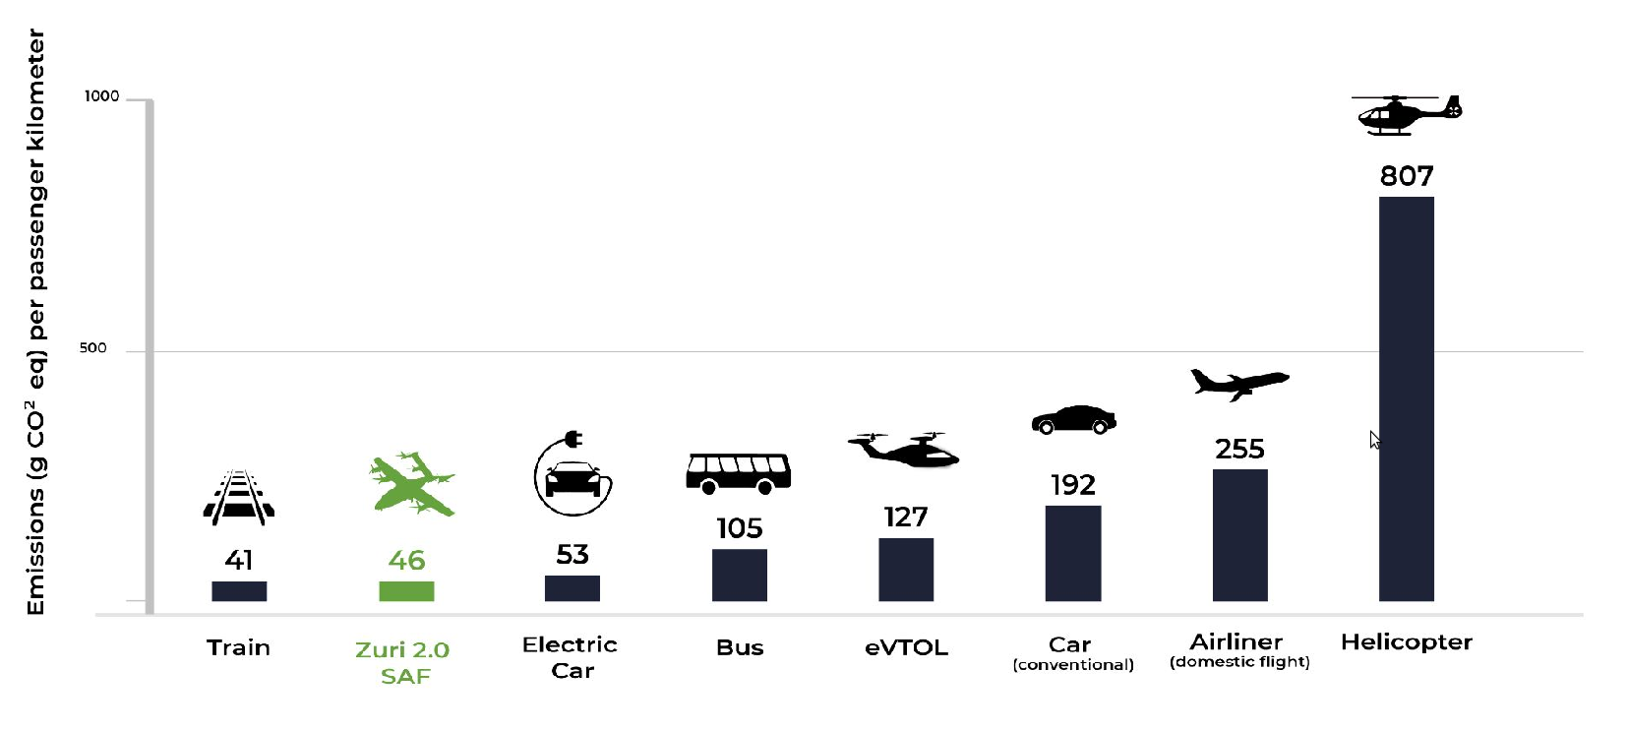
Sustainability: SAF
How can a hybrid VTOL have lower emissions than all-electric VTOL?!
There are 3 reasons, the main one is SAF - Sustainable Aviation Fuel
Using SAF in turbogenerator produces only 136 g CO₂ eq / kWh - source
Recharging eVTOL from electricity grid produces 275 g CO₂ eq / kWh, twice as much! - source

Slide 16
Sustainability: Batteries
Second reason: Smaller batteries
Zuri has 3x smaller batteries than eVTOL
Battery lifecycle (manufacturing, recycling) has emissions: (source)
73 kg CO₂ eq / kWh
Third reason: Longer flights
Zuri flies 500-700 km compared to 50-100 km for eVTOL
Generally, one flight means one battery lifecycle.
So our battery lasts for 10x longer distance before it needs to be replaced.

Slide 17
Executive summary
VTOL for regional travel = no need for airports
It’s hybrid = 7x longer usable range than all-electric eVTOLs, low emissions
3x cheaper to purchase and operate than comparable helicopters
Extremely money-efficient - just $1.5M to build and fly large demonstrator
Huge market - $590B in 2035

